Slide 1
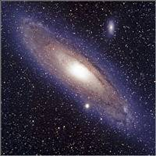
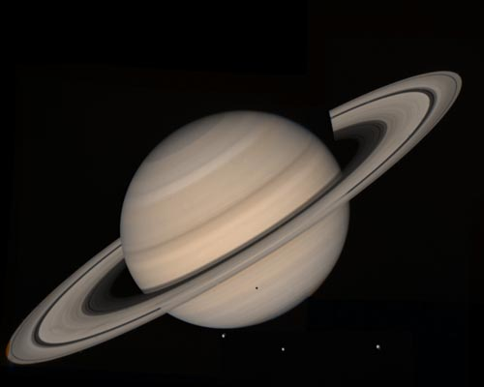
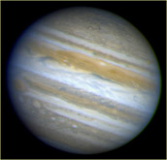
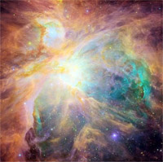
Celestial
Favorites!

Slide 2

Iota Cancri
Through The Telescope
When seen through our big telescope,
It’s not one star but two!
Not only is one yellow,
But the other one is blue.

Slide 3
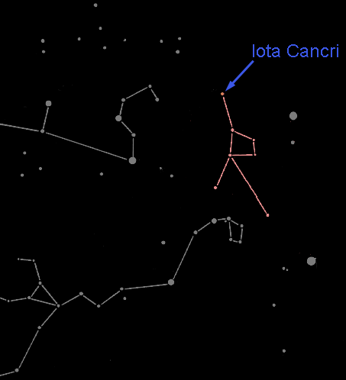
Iota Cancri In The Night Sky
This star pair is in the dim constellation of Cancer the Crab.

Slide 4
Iota Cancri
Contrast Optical Double Star
We have found the distances to these two stars: The blue star is 188 light years from us, and the yellow star is 298 light years away.
The stars are separated by 110 light years! They can’t be orbiting each other and are therefore not a binary system.

Slide 5
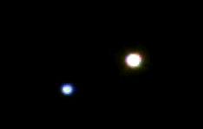

Star Pairs
Pairs of stars come in two varieties:
Optical Double Stars
Binary Stars

Slide 6

Optical Double Stars
Optical double stars are two stars that happen to lie in the same direction in the sky.
(A side view)
If you could see these stars from somewhere in space other than Earth, you would see that they have nothing to do with each other.

Slide 7


Binary or Multiple Stars
In a Binary (or Multiple) star system the stars are relatively close together and orbit each other.

Slide 8

Multiple or Optical Double?
It's all in the distance.
Optical double stars are very large distances apart but appear to be close together because they are in the same line-of-sight.
Multiple stars lie close to each other in space and at about the same distance from Earth.

Slide 9
Contrast Optical Double Stars
In the case of Iota Cancri, the yellow star is almost twice as far away from us as the blue star.
Since the yellow star is brighter, then it must also be larger than the blue one.
The yellow star is starting to die, which causes it to expand.

Slide 10
How Can You Find the Distance to a Star?
Earth
Nearby star
ρ
Background stars
Sun
d
ρ
Apparent positions of the nearby star for observations taken 6 months apart.
The position of a nearby star from different sides of our orbit around the Sun make it seem to shift in the sky. This shift, called parallax, can be used to find the distance to nearby stars.

Slide 11
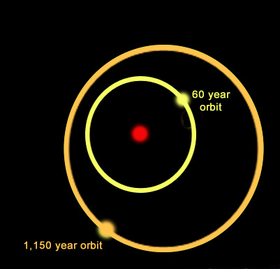
Multiple Star Systems
Star systems come in many varieties. For example, the system shown here is a triple star system:
A yellow star orbits a primary star with a period of nearly 60 years while a more distant companion orbits the inner pair with a period of 1,150 years.
One multiple star system we know of has 9 stars!

